Slide 1
Reactive Programming
Introductory Concepts
sambath.narayanan@dataeverconsulting.com

Slide 2
Agenda
Programming Concepts
Reactive Programming
RxJS Concepts
RxJS Library
Coding Demo
2

Slide 3
Agenda
Async Programming
Data Stream
RxJS Terminology
Marble Diagram
Observables
Observer
Pipe & Operators
Handling Errors & Completions
Types of Operators
3

Slide 4
Event Driven Programming
You build your program so that it reacts to user actions — such as mouse clicks, key presses, and voice-activation — sensor outputs, or messages containing data from other programs — including programs running on other servers.
These are called events
4

Slide 5
What is a Data stream?
Events happening one after another over a time is called a stream
examples : group of people chatting online, shopping cart application of an e-commerce site
5

Slide 6
Shopping cart is a Data stream
Consider an e-commerce shopping-cart website
Customer visits the site and places an order
Order and shipping status will change over time /continuously changing (one variable takes different values over period of time)
Order status = Null (before order is placed)
Order status = Order placed
Order status = Order received
Order status = Order getting processed
Order submitted
This needs to be informed/updated to multiple applications
Customers, others can check updates which changes over time
6

Slide 7
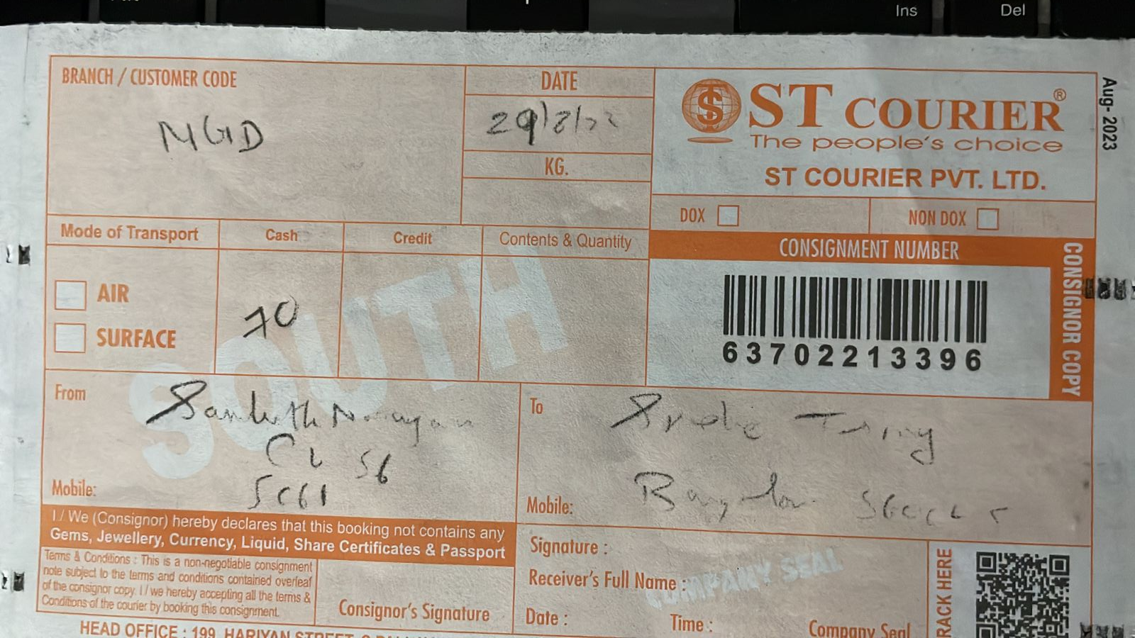
7

Slide 8
Courier online status is a Data stream
Consider a courier company
Customer sends a packet from destination A to destination B
Courier shipping status will change over time /continuously changing (one variable takes different values over period of time)
Order status = Null (before order is placed)
Order status = Packet picked
Order status = packet has reached source hub
Order status = Packet is in transit
Order status = packer reach destination hub
Order status = packet out for delivery
Customer and others can check updates which changes over time
8

Slide 9
Data stream? Example 3
Can you think of any other example ?
9

Slide 10
Registered Subscriber
You subscribe to a Youtube channel
You get an update whenever there is a new video is posted
You get an update about the order status
You get an update about the courier shipment
Remember AWN – airway bill number ?
10

Slide 11

11

Slide 12
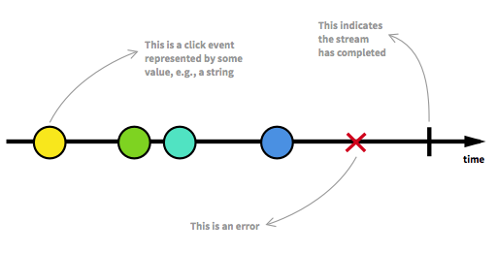
Data Stream
A data stream is a sequence of ongoing events ordered in time.
It can emit three different things:
a value (of some type),
an error, or
a "completed" signal.
We capture these emitted events only asynchronously, by defining a function that will execute when a value is emitted.
12

Slide 13
The other illustration
--a---b-c---d---X---|->
a, b, c, d are emitted values
X is an error
| is the 'completed' signal
---> is the timeline
13

Slide 14
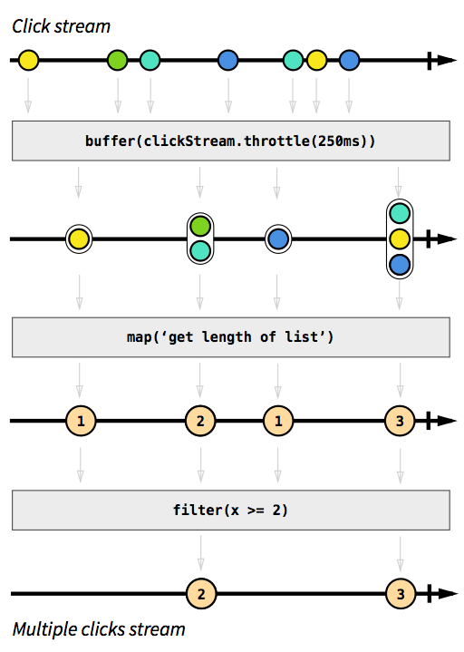
Understand and build streams
Grey boxes are functions transforming one stream into another.
First we accumulate clicks in lists, whenever 250 milliseconds of "event silence" has happened (that's what buffer(stream.throttle(250ms)) does, in a nutshell.
The result is a stream of lists, from which we apply map() to map each list to an integer matching the length of that list.
Finally, we ignore 1 integers using the filter(x >= 2) function. That's it: 3 operations to produce our intended stream.
We can then subscribe ("listen") to it to react
14

Slide 15
What is Sync Programming ?
Declares a string called name
Declares another string called greeting,which uses name
Outputs the greeting to the JS console
Browser effectively steps thru the program one line at a time. This makes the sync program
sync programming is blocking
const name = “Shubh”;
const greeting = ‘Hello, my name is $(name)’;
console.log(greeting);
//”Hello my name is Shubh!”
15

Slide 16


What is Async Programming ?
Async programming is a technique that enables your program to start a potentially long running task and still be able to be responsive to other events while that task runs, rather than having to wait until that has finished
Example : making HTTP requests using fetch()
Async programming is non-blocking
16

Slide 17
Asynchronous Programming
To display useful data to your user on their screen, you first need to have that data in your application.
If you need data that your application doesn’t have hard-coded into it, then you’ll have to get that data from somewhere, usually a server on the internet somewhere.
To get that data you’re going to have to make an HttpRequest to that server asking for it.
17

Slide 18
Asynchronous Programming
It’s impossible to know exactly how long it will take before that server will deliver your data to your application.
Therefore it took an indefinite amount of time to accomplish that piece of logic giving you the data you asked for.
The response didn’t come synchronously — or line after line of code — instead it came whenever it came.
Usually, you’ve written some code prepared to do something with that data upon receipt. That’s why it’s called asynchronous.
18

Slide 19












Slide 20
Callback
Callback is a function that is passed into another function as an argument, with the expectation that callback will be called at the appropriate time.
These functions are executed when the asynchronous operation is complete or when a particular event occurs
Callback is the primary method asynchronous functions were implemented in JS
Callbacks allow you to specify what should happen after an asynchronous operation finishes without blocking the main program execution.
function doSomethingAsync(callback) {
setTimeout(function () {
console.log("Task done!");
callback(); // Call the callback function when the task is done
}, 1000);
}
function afterTask() {
console.log("Callback function called.");
}
doSomethingAsync(afterTask);
20
Notes:
Callback Function: Callbacks are functions that you pass as arguments to asynchronous functions.
These functions are executed when the asynchronous operation is complete or when a particular event occurs.

Slide 21
What is a promise?
A promise is an object returned by an asynchronous function which represents the current state of the operation
21

Slide 22
// Simulate an asynchronous API request
function fetchDataFromApi() {
return new Promise((resolve, reject) => {
setTimeout(() => {
const data = { message: 'Data fetched successfully' };
const error = false; // Change to true to simulate an error
if (!error) {
resolve(data); // Resolve the Promise with the data
} else {
reject('Error: Failed to fetch data'); // Reject the Promise with an error
}
}, 2000); // Simulate a 2-second delay
});
}
// Usage of the fetchDataFromApi function
console.log('Fetching data...');
fetchDataFromApi()
.then(data => {
console.log('Data received:', data);
})
.catch(error => {
console.error('Error:', error);
});
console.log('Async operation started...');
node index_async.mjs
22

Slide 23
How to use promises?
Promises are foundations of Async programming in JS.
Promise object provides methods to handle eventual success or failure of the operation
23

Slide 24
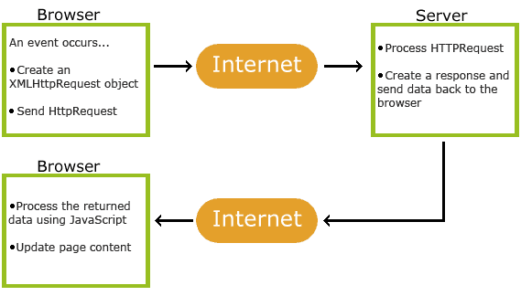
Asynchronous JavaScript and XML(AJAX)
24

Slide 25
Reactive Programming
25

Slide 26
What is a Reactive Programming ?
Reacting to User actions
Mouse click, sensor out put, keyboard input
React framework is different and Reactive Programming is different
Functional programming
Event driven programming
RP is an asynchronous programming paradigm concerned with Data streams and the propagation of change
26

Slide 27
What is a Reactive Programming ?
Simplifying further
RP is altogether different way of developing application software
App software is created to react to changes that happen events that happen( click, data loading, http call)
instead of …
where we explicitly write the code to handle those changes
27

Slide 28
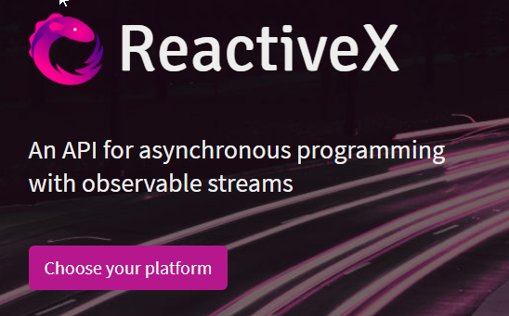





What is RxJS ?
RxJS is a library for composing asynchronous and event based programs by using observable sequences
It provides
one core type observable
satellite types operators to allow handling asynchronous events as collections.
Satellite data type – observer, subject (specifying data type)
Operator – map, max, filter, reduce
npm list --depth=0
laith@1.0.0
└── rxjs@7.8.1
28

Slide 29
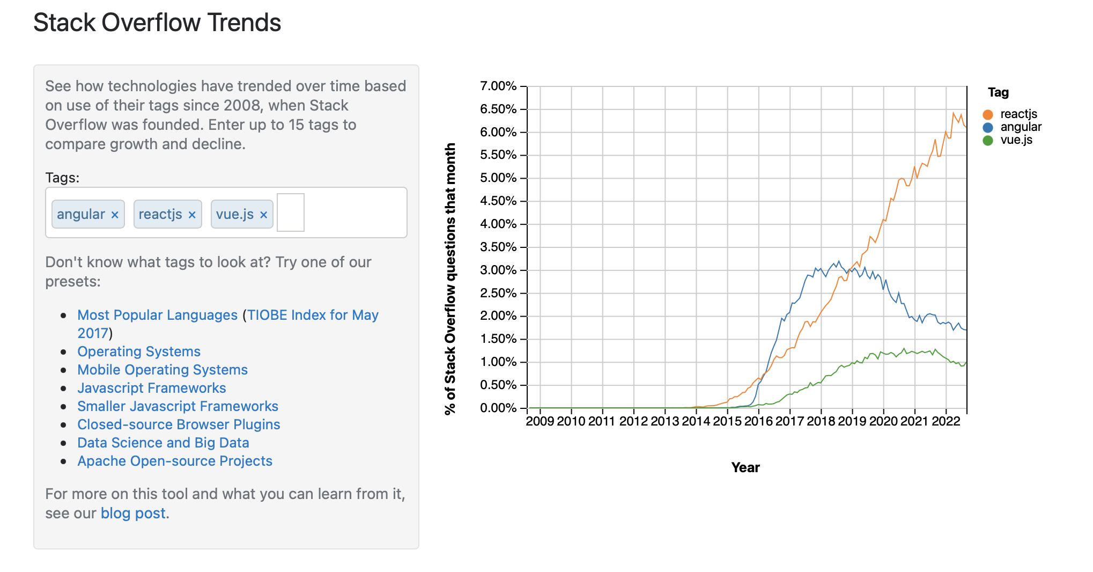
When we have Promises, why RxJS?
29

Slide 30
Key RxJS Concepts
Observable:
Observer:
Subscription:
Operators
Subject:
30

Slide 31
Observable
An observable emits some data
An observable is a data source where values are expected, like clicks, mouse events, an Http requests, sensor data etc.
Observable could emit single data or multiple data or stream of data
Source of data or events that can be observed by one or more observers
31
Notes:
DOM (Document Object Model) event refers to an event that occurs in a web page's Document Object Model, which is a hierarchical representation of the web page's structure and content. DOM events are events triggered by user interactions

Slide 32
Arrays & Objects vs. Observables
Arrays
Arrays are like boxes which contain things, one or many. But you know what is put inside the box, when it is put, when it is taken
Objects
Objects are also like arrays.
Observables
But in observables, things can come any time and when it comes you can take them and use them
32
Notes:
DOM (Document Object Model) event refers to an event that occurs in a web page's Document Object Model, which is a hierarchical representation of the web page's structure and content. DOM events are events triggered by user interactions

Slide 33
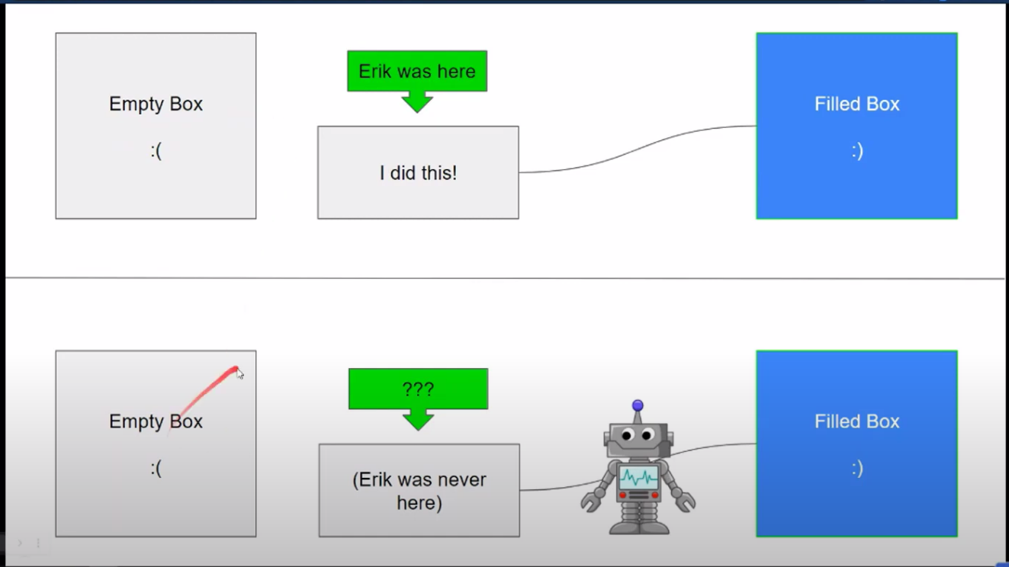
Array / Object
Observable
33

Slide 34
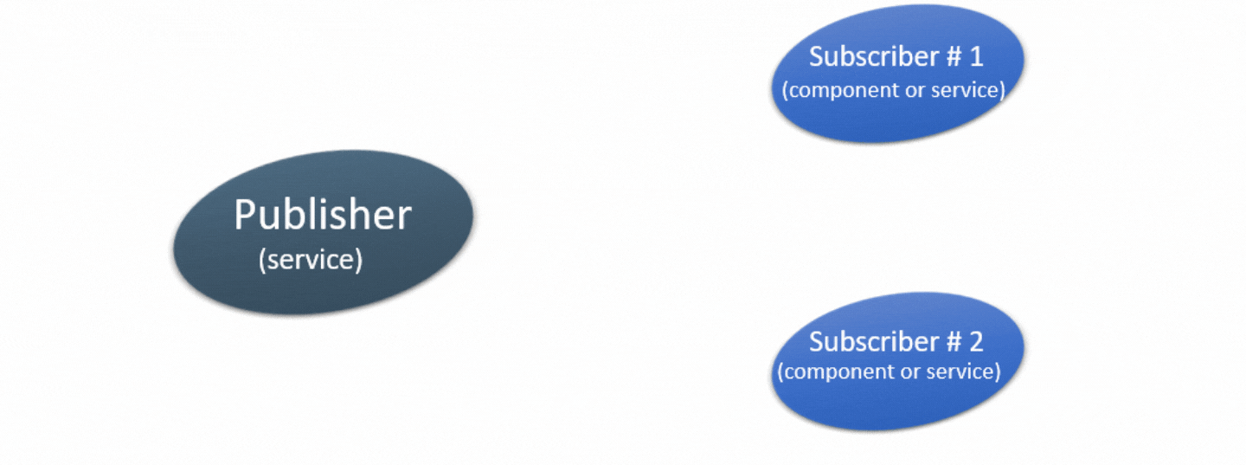
Observables from RxJs Programmatic description
Observables is a new push-system for JS
An observable is a producer of multiple values and pushing them to observers
Observables provide support for passing messages between publishers and subscribers in your application. They offer significant benefits for asynchronous programming and handling multiple values.
Subscriber #1
(component or service)
Publisher
(service)
Subscriber #2
(component or service)
34
Notes:
RxJs (Reactive Extensions for JavaScript) provides an easy way to compose asynchronous and event-based programs through observable sequences
Reactive Programming is an asynchronous programming concept that is concerned with data streams as well as the propagation of change
Observables can be viewed as a sequence of items that arrive asynchronously over time

Slide 35
Promises vs Observables
Promises
Observables
No ways to cancel promises
Observables can be cancelled
// Create a Subject (creating new Observable using Subject // // method
const mySubject = new Subject();
// Complete the Subject (optional)
mySubject.complete(); // Further emissions will not be received by observers after // the Subject is completed
mySubject.next('Fifth value');
35

Slide 36
RxJS concepts - Observer
const observer = {
next: (value) =>{
console.log("Observer got a value of" + value);
},
error: (err) =>{
console.log("Observer got an Error" +err);
},
complete: () =>{
console.log("Observer got a Complete Notification");
}
Observer is an object
Observer has three methods
next
error
complete
Observer will get called when there is and interaction with the observable
i.e. the source interacts for an example button click, Http request, etc.
36
Notes:
DOM (Document Object Model) event refers to an event that occurs in a web page's Document Object Model, which is a hierarchical representation of the web page's structure and content. DOM events are events triggered by user interactions

Slide 37
Subscription
When the observable is created, in order to execute the observable we need to subscribe to it.
Observables can’t do anything unless they are subscribed to
It can also be used to cancel the execution.
observable.subscribe(observer);
37
Notes:
DOM (Document Object Model) event refers to an event that occurs in a web page's Document Object Model, which is a hierarchical representation of the web page's structure and content. DOM events are events triggered by user interactions

Slide 38
Subscribing and Observers
The "listening" to the stream is called subscribing.
The functions we are defining are observers.
38

Slide 39
Subscribing
Subscriber listens to the observable for data changes or updates
A subscription is returned when you call subscriber on an observable
Data status (Order status) is always the latest since we have subscribed to the observable
const observable = new Observable((subscriber) => {
subscriber.next(users);
}).pipe(
map((value) => {
console.log("1). Got Data from Observable",value)
return value.data
})
39

Slide 40
How to get data from an Observable
This is how we subscribe to an observable(see demo example)
const {Observable} = require("rxjs")
const observable = new Observable((subscriber) => {
subscriber.next(100);
})
We have to call the subscribe method and pass a callback function as a parameter(arrow function)
Inside callback we will emit the data. In order to emit, we have to get subscriber parameter. We have to use subscriber.next
The callback function will be called every time the observable emits a new value.
That new value is passed as a parameter to the callback function.
Observable
emit value 100
cp index.js.data index.js
node index
Notes:
LAITH: 1.
2.
3.
4..
Code demo can be accessed at https://stackblitz.com/edit/at-rxjs-demo1?embed=1&file=src%2Fapp%2Fapp.component.html,src%2Fapp%2Fapp.component.ts
An observable can deliver multiple values of any type—literals, messages, or events, depending on the context. The API for receiving values is the same whether the values are delivered synchronously or asynchronously. Because setup and teardown logic are both handled by the observable, your application code only needs to worry about subscribing to consume values, and when done, unsubscribing. Whether the stream was keystrokes, an HTTP response, or an interval timer, the interface for listening to values and stopping listening is the same. Because of these advantages, observables are used extensively within Angular, and are recommended for app development as well.

Slide 41

Observables can be seen as a newspaper subscription
When we subscribe to a newspaper, we expect to receive several issues over time.
Those issues are delivered at a specific location: The address we give when we subscribe is equivalent to the callback function we pass to the subscribe method.
That subscription will complete at some point (for instance after a given number of months)

Slide 42
RxJS more concepts
Operators
An operator is a pure function that takes in observable as input and the output is also an observable.
Subject
A subject is an observable that can multicast i.e. talk to many observers. Consider a button with an event listener, the function attached to the event using addlistener is called every time the user clicks on the button similar functionality goes for subject too.
Schedulers
A scheduler controls the execution of when the subscription has to start and notified.
42

Slide 43
Create an Observable

Slide 44
Ways to create Observable
Using an RxJS creation operator
Using an RxJS subject
44

Slide 45
RxJs Subjects
There are several kinds of subjects:
Subject Emits next value to current subscribers
BehaviorSubject Emits latest value to current and future subscribers
ReplaySubject Emits one-or-more previous values to future subscribers
AsyncSubject will only emit the last value upon completion of the Observable
45
Notes:
Demo code: https://stackblitz.com/edit/at-rxjs-demo5?file=src%2Fapp%2Fheader%2Fheader.component.html,src%2Fapp%2Fcard%2Fcard.component.ts,src%2Fapp%2Fcountry.service.ts
For more examples and demos of the different kinds of subjects: https://blog.angulartraining.com/rxjs-subjects-a-tutorial-4dcce0e9637f

Slide 46
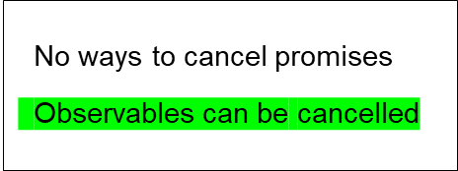
Ways to create Observable Using an RxJS subject
import { Subject } from 'rxjs'; // Create a Subject
const mySubject = new Subject(); // Subscribe to the Subject (Observable)
mySubject.subscribe({
next: value => console.log(`Observer 1 received: ${value}`),
error: error => console.error(`Observer 1 error: ${error}`),
complete: () => console.log('Observer 1 completed'),
}); // Emit values using the Subject
mySubject.next('First value');
mySubject.next('Second value');
mySubject.next('Third value'); // Another observer subscribing to the same Subject
mySubject.subscribe({
next: value => console.log(`Observer 2 received: ${value}`),
error: error => console.error(`Observer 2 error: ${error}`),
complete: () => console.log('Observer 2 completed'),
}); mySubject.next('Fourth value'); // Complete the Subject (optional)
mySubject.complete(); // Further emissions will not be received by observers after the Subject is completed
mySubject.next('Fifth value');
Can try the following
BehaviorSubject
ReplaySubject
AsyncSubject
Observer 1 received: First value
Observer 1 received: Second value
Observer 1 received: Third value
Observer 1 received: Fourth value
Observer 2 received: Fourth value
Observer 1 completed
Observer 2 completed
46
node index_subject.mjs

Slide 47
Ways to create Observable ?
Using an RxJS creation operator
Using an RxJS subject
47

Slide 48
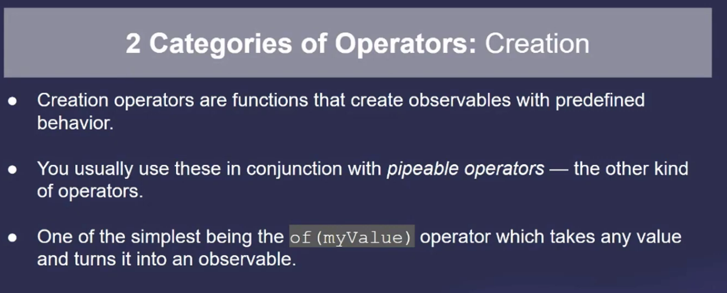
48

Slide 49
Using RxJS creation operator: of
The simplest way to create an Observable from static data. It is an easy-to-use wrapper that accepts any sequence of data as input and returns a ready to use Observable.
of(10, 20, 30).subscribe(
next => console.log('next:', next),
err => console.log('error:', err),
() => console.log('the end'),
);
Output:
'next: 10’
'next: 20’
'next: 30’
the end
node index_of.mjs
49

Slide 50
Using RxJS creation operator: from
The simplest way to create an Observable from static data. It is an easy-to-use wrapper that accepts any sequence of data as input and returns a ready to use Observable.
import { from } from 'rxjs';
const observable = from([1, 2, 3, 4]);
// Three states => next, complete, error
observable.subscribe({
next: (value) => console.log("Next value:", value),
complete: () => console.log("Infinity is Done!!! ¯\_(ツ)_/¯ "),
error: (err) => console.log("No, Ew Binod", err),
});
Output:
Next value: 1
Next value: 2
Next value: 3
Next value: 4
Infinity is Done!!!
node index_observable_from.mjs
50

Slide 51
Using operators with RxJs

Slide 52
Marble diagrams
Check the extensive list of operator(open the web link)
https://www.learnrxjs.io/learn-rxjs/operators
52

Slide 53
Marble diagrams
Observables are perfect to subscribe to a stream of events, and as a result an Observable’s lifecycle is usually represented with a timeline such as this one, known as a marble diagram: The above example of Observable emits 5 different values over time (circles/marbles in the timeline), before completing some time later ( | in the timeline)

Slide 54
RxJs Operators
Operators are pure functions that take one or more Observables and return a modified Observable
Operators are used to transform/filter/concatenate information from one or more sources
RxJs has over 120 operators available!
Operators are applied to an Observable using the pipe method:
observable.pipe(
map(data => data.toUpperCase())
).subscribe(newValue => {
this.currentSelection = newValue;
});
Notes:
Operators offer the best way of consuming or utilizing Observables. With an operator, you can manipulate, change, or filter an Observable to yield a desired result.

Slide 55
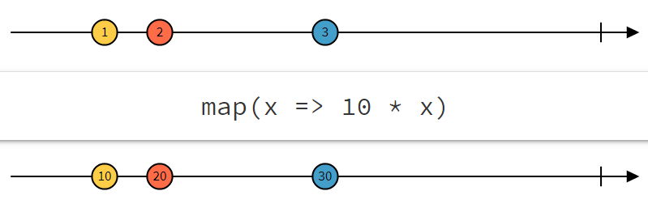
RxJs Operators: map
Below is an example of the map operator used to apply a transformation to the data coming from an Observable
Notes:
The above example illustrates the map operator. This operator takes every single value from an Observable and applies a transformation to them, then emits the updated value.
Marble diagrams always represent the input observable at the top, then the operator with a sample configuration (in our case, the operator is set to multiply any input value by 10), and the output observable at the bottom.
The timeline from left to right represents different values emitted by the observables over time. The vertical line on the right-hand side represents the completion of the observable. No more value can be emitted after that.

Slide 56
Using RxJS operator: map
The map operator accepts each new value emitted by the observable, transforms it, and passes it along to the next Operator in the pipe
import { range } from 'rxjs';
import { map } from "rxjs/operators";
// Another RxJS creation operator that
// starts at 0 and emits 1000 values
range(0, 1000)
.pipe( map (x => x * 10))
.subscribe(
next => console.log('next:', next),
err => console.log('error:', err),
() => console.log('the end'),
);
Output:
'next: 0'
'next: 10'
'next: 20'
....
'next: 10000'
the end
node index_map.mjs
56

Slide 57
Operators with our newspaper subscription example
When we subscribe to a newspaper, we expect to receive several issues over time.
It's likely that we don't need the contents of the entire newspaper: Some people will clip the coupons page, others will read the sports news only.
That's what operators do: They tweak what we do with a subscription to make it match our expectations.
As a result, operators can filter out some data, aggregate some information, etc.
57

Slide 58
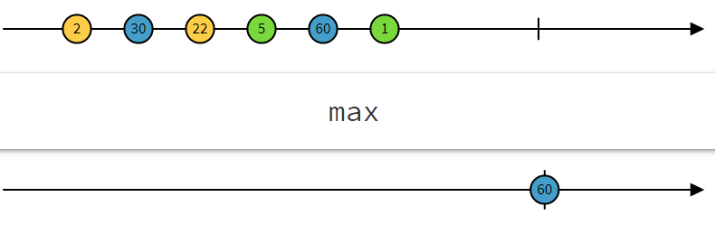
RxJs Operator: max
max is a mathematical operator. It returns a single value, which is the maximum value emitted by the input observable as soon as the subscription is completed:
58

Slide 59
Using RxJS operator: max
import { of, max } from 'rxjs';
of(2, 30, 22, 5, 60, 1)
.pipe(max())
.subscribe((v) => console.log(`value: ${v}`));
Output:
max value: 60
node index_max.mjs
59

Slide 60
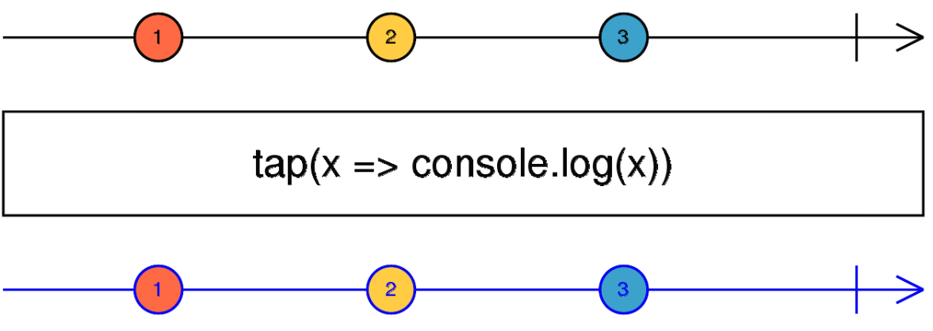
RxJs Operator: tap
tap returns an Observable identical to the source, but runs the specified callback for each item - a way to “spy” on an Observable and run some side-effects on its data:
60

Slide 61
Using RxJS operator: tap
import { of } from 'rxjs';
import { tap } from 'rxjs/operators'; const numbers$ = of(1, 2, 3); numbers$
.pipe(
tap(value => console.log(`Original value: ${value}`)),
tap(value => console.log(`Doubling: ${value * 2}`)),
tap(value => console.log(`Squaring: ${value * value}`))
)
.subscribe(value => console.log(`Final value: ${value}`));
Original value: 1
Doubling: 2
Squaring: 1
Final value: 1
Original value: 2
Doubling: 4
Squaring: 4
Final value: 2
Original value: 3
Doubling: 6
Squaring: 9
Final value: 3
node index_max.mjs
61

Slide 62
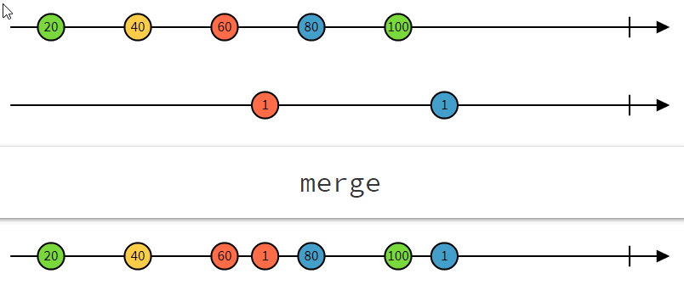
RxJs Operator: merge
merge is a combination operator. It merges two different observables into one:
62

Slide 63
Using RxJS operator: merge
import { merge, interval } from 'rxjs';
import { take } from 'rxjs/operators';
// Create two observables
const observable1$ = interval(1000).pipe(take(3)); // Emits 0, 1, 2 every second
const observable2$ = interval(500).pipe(take(4)); // Emits 0, 1, 2, 3 every half-second
// Merge the two observables
const merged$ = merge(observable1$, observable2$);
// Subscribe to the merged observable
merged$.subscribe(value => console.log(`Merged Value: ${value}`));
Merged Value: 0
Merged Value: 0
Merged Value: 1
Merged Value: 2
Merged Value: 1
Merged Value: 3
Merged Value: 2
node index_merge.mjs
63

Slide 64
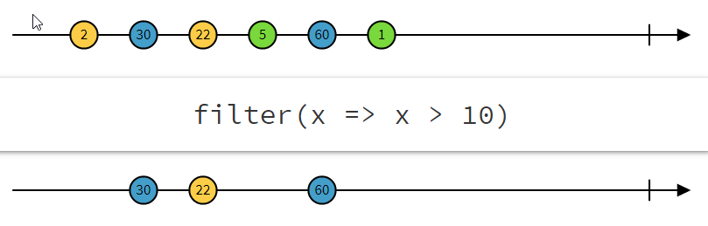
RxJs Operator: filter
filter is a filtering operator. It filters out data that doesn’t match a given condition:
64

Slide 65
RxJs Operator: filter Coding example
filter is a filtering operator. It filters out data that doesn’t match a given condition:
map((value) => {
console.log("2). Got Data from first operator",value)
return value.filter((user) => user.status == "active");
}),
{ status: 'active', age: 15 },
{ status: 'active', age: 12 },
{ status: 'active', age: 16 },
{ status: 'active', age: 21 } cp index.js.filter index.js
node index.js
Simply
filter out
Send this value to next operator
or
send this value to observer
output
65

Slide 66
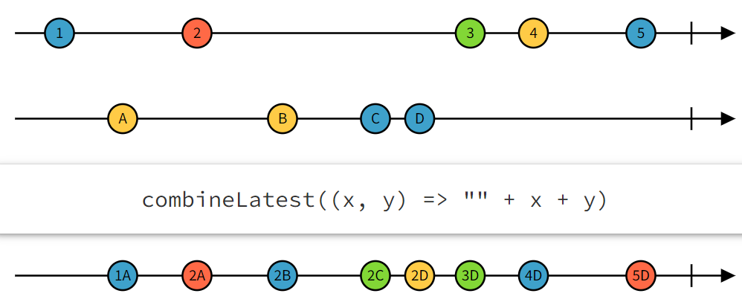
Some RxJs Creation Operators
https://rxmarbles.com/ is a great resource to learn more about operators in a visual way. combineLatest:
66

Slide 67
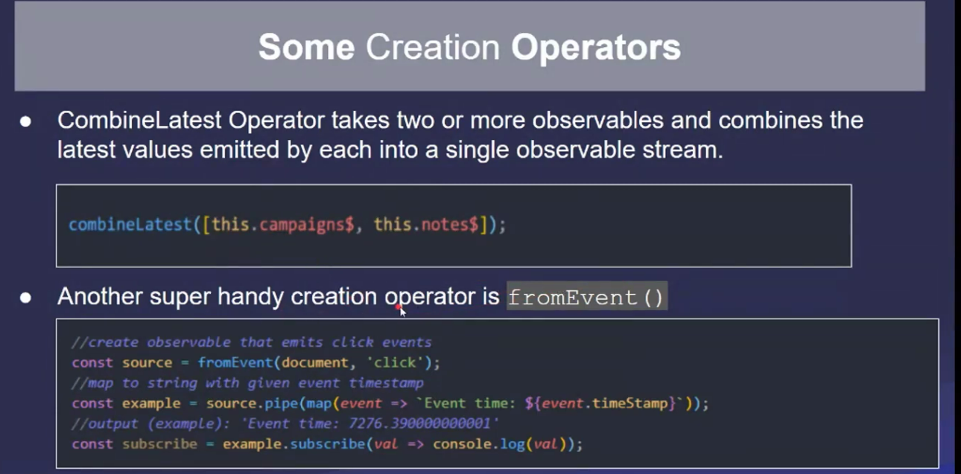
67

Slide 68
Using pipeable operators with RxJs
68

Slide 69
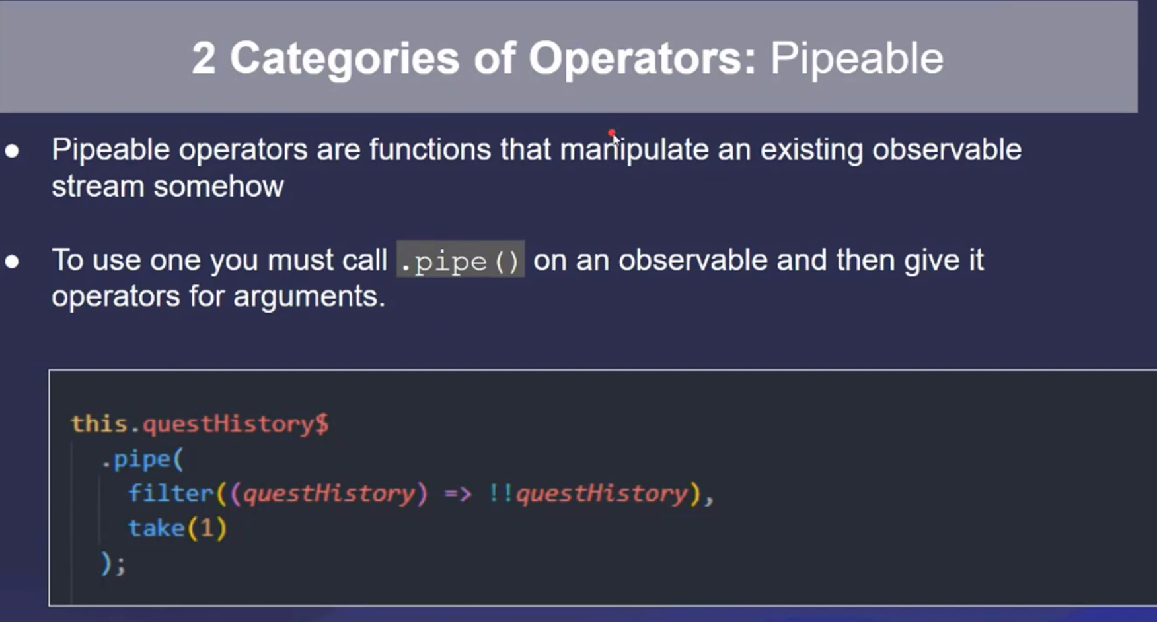
69
Notes:
(quest.History): This part appears to be the input parameter of the arrow function. It takes an object called
quest.History as its input.
It takes an object, quest.History, as its input.
It applies the double negation operator (!!) to the quest.History object.
The double negation operator effectively converts the quest.History object to its boolean equivalent.
If quest.History is a truthy value (e.g., an object with content), it will be converted to true.
If quest.History is a falsy value (e.g., null or undefined), it will be converted to false.

Slide 70
Some More Pipeable Operators
The Map Operator is the go-to for transforming observable’s value to something different
A The SwitchMap Operator should be the first-choice of operators when you want to swap – mid-stream – what observable you are listening
70

Slide 71
RxJs Operator
Filter – look only at videos but not community messages
Map – map to all users
71

Slide 72
RxJS
(Reactive eXtensions for Java Script)
Environment
72

Slide 73
RxJS environment
Node.JS
NPM
RxJS
webpack
73

Slide 74
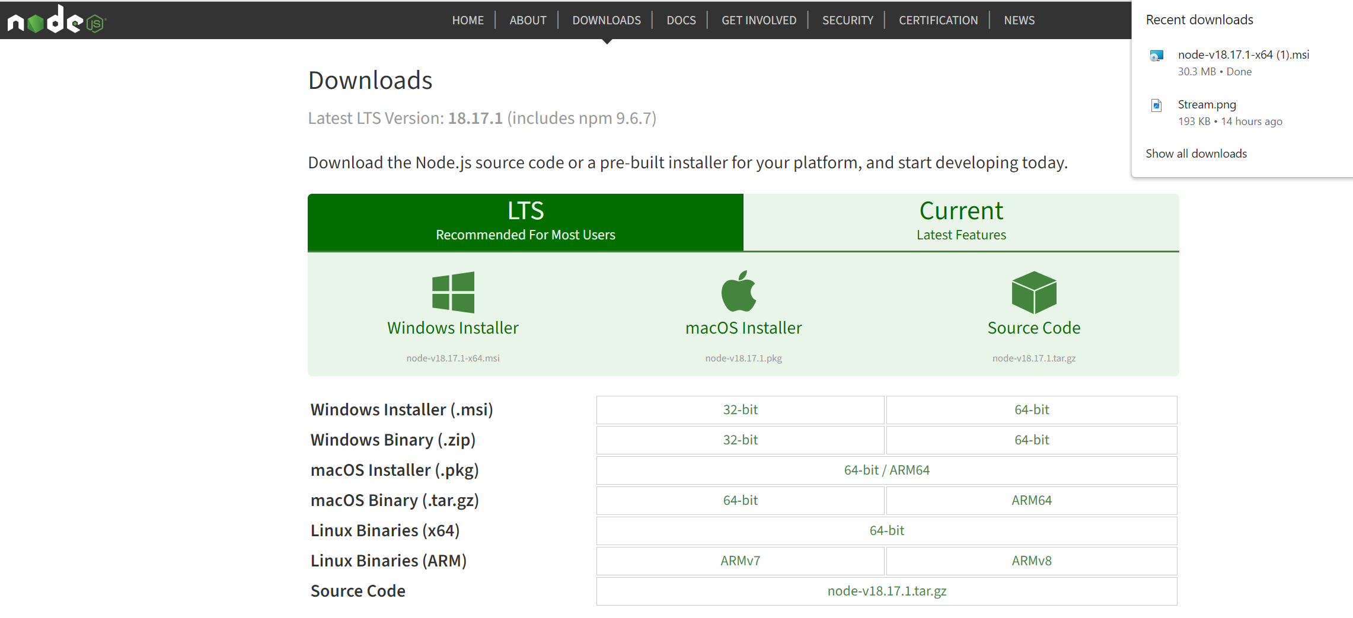
Node.js
Node.js asynchronous event-driven JavaScript runtime.
74

Slide 75
nodejs and npm installation
You need to have nodejs and npm installed on your system.
To verify if NodeJS and npm is installed on your system, try to execute the following command in your command prompt.
>node -v
v18.17.1
>npm -v
6.4.1
75

Slide 76
Node.js
Node.js asynchronous event-driven JavaScript runtime.
Thread-based networking is relatively inefficient and very difficult to use.
Users of Node.js are free from worries of dead-locking the process, since there are no locks.
Almost no function in Node.js directly performs I/O, so the process never blocks.
Because nothing blocks, scalable systems are very easy to develop in Node.js.
76

Slide 77
NPM
NPM is software registry
Consists of
website
CLI
registry
77

Slide 78
Conclusions
RxJs has a lot of cool features but has a learning curve
Remember that there are 120+ operators available to help you out
Subjects are the most important skill to master. Operators come second, as there’s only a handful of them that we need on a daily basis (map, filter, tap, switchMap, forkJoin are likely 90%+ of what you’ll ever need)
78

Slide 79
Additional material
https://www.sitepoint.com/webpack-beginner-guide/
https://www.javatpoint.com/rxjs-first-example
https://www.youtube.com/watch?v=ztspvPYybIY
https://nodejs.org/en/download/
https://nodejs.org/en/docs/guides/blocking-vs-non-blocking
https://www.youtube.com/watch?v=uQGl9x9VHgA
https://www.youtube.com/watch?v=PhggNGsSQyg&t=342s
79

Slide 80
Reactive Programming
Concepts
sambath.narayanan@dataeverconsulting.com
80

Slide 81
Pure function
A pure function is a fundamental concept in functional programming, and it plays a crucial role in the design and reliability of programs. Here are the key characteristics of a pure function:
Deterministic: A pure function is deterministic, meaning that for the same input, it will always produce the same output.
No Side Effects: A pure function does not have any side effects. It does not modify any variables outside of its own scope, and it does not perform actions that have observable effects on the external world, such as I/O operations, network requests, or changing global state.
Referential Transparency:, which means that you can replace a function call with its result without changing the program's behavior.
Stateless: Pure functions do not rely on or modify any external state. They only depend on their input parameters and do not access or modify global variables,
Immutable: Pure functions typically do not mutate their input data
81

